Slide 1



Synergies and Trade-Offs in Land-Based Climate Mitigation and Biodiversity
COP21, Rio Pavilion, 1100 – 1230

Slide 2
What this session is about …
Land use/cover is critical in mitigating climate change: reforestation, avoided deforestation, bioenergy production and agricultural management
A purely climate focus risks ignoring the negative impacts of land-based mitigation on the broader environment, e.g. biodiversity, air quality, N emissions
This session will explore synergies (co-benefits), trade-offs and constraints - identifying ways forward to maximize benefits and minimize trade-offs

Slide 3


The limitations and constraints to land-based mitigation
Mark Rounsevell, Peter Alexander & James Paterson
Institute of Geography & the Lived Environment
School of Geosciences
University of Edinburgh

Slide 4
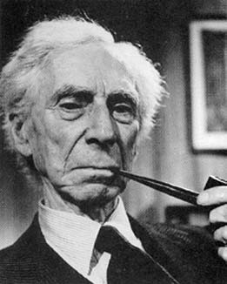
What are the uncertainties in estimating land-based mitigation and nature?
« The whole problem with the world is that fools and fanatics are always so certain of themselves, but wiser people so full of doubts »
Bertrand Russell

Slide 5
Uncertainties in land use models

Slide 6
Global coefficient of variation and variance components

Slide 7
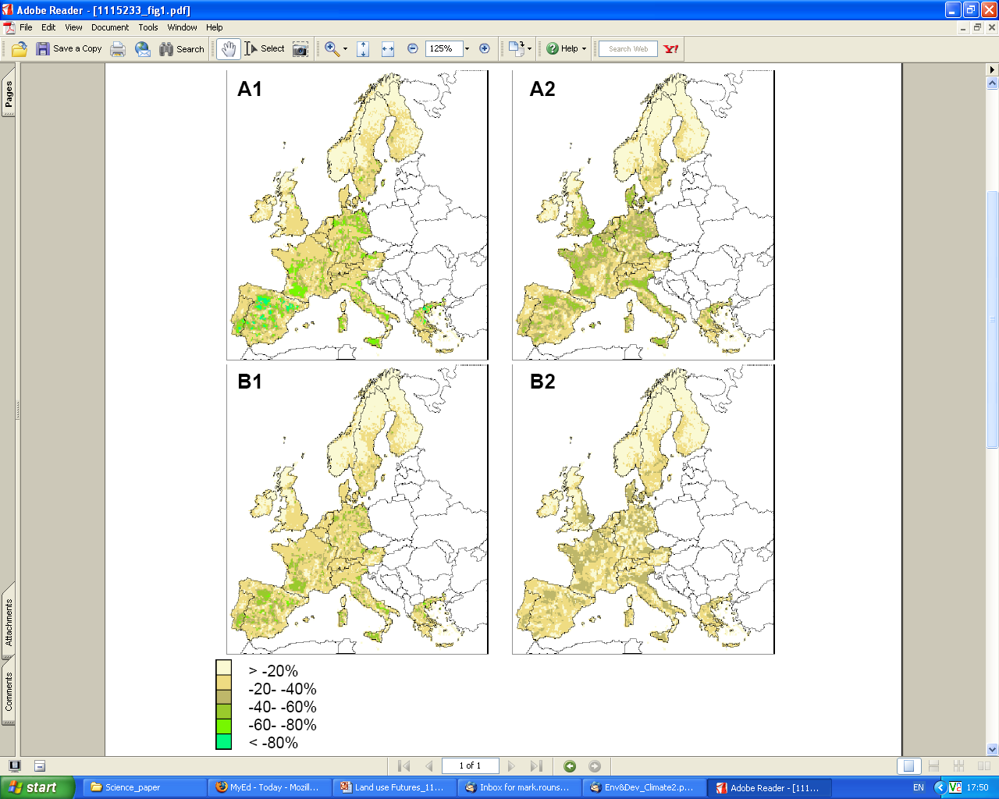
The trade-off between intensification and extensification
Change in cropland area (for food production) by 2080 compared to baseline (%) for the 4 SRES storylines and HADCM3
After: Schröter et al. (2005). Ecosystem service supply and vulnerability to global change in Europe. Science, 310 (5752), 1333-1337

Slide 8
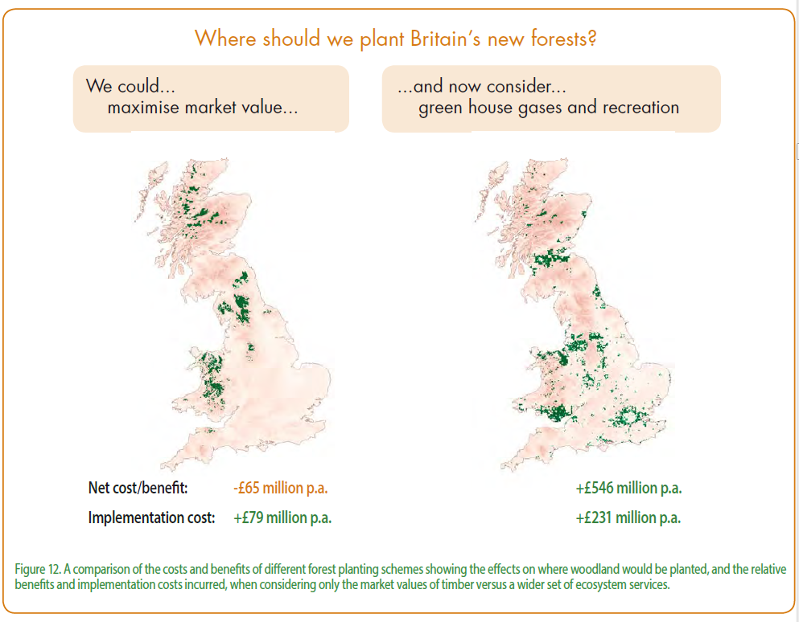
Source: UK National Ecosystem Assessment (2014) The UK National Ecosystem Assessment: Synthesis of the Key Findings. UNEP-WCMC, LWEC, UK.

Slide 9
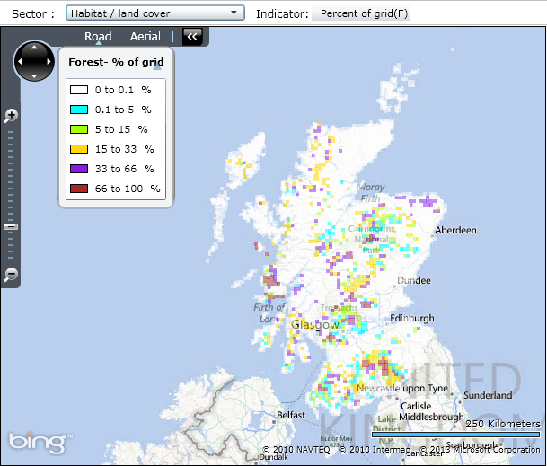
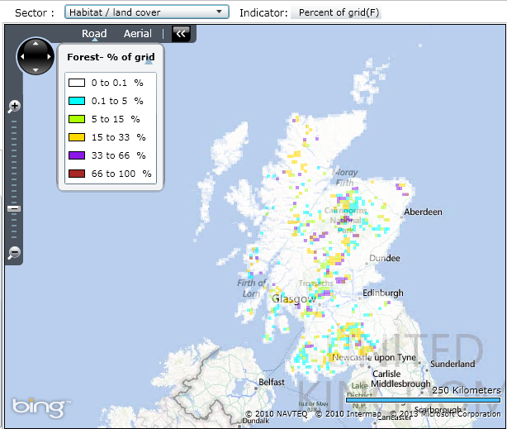
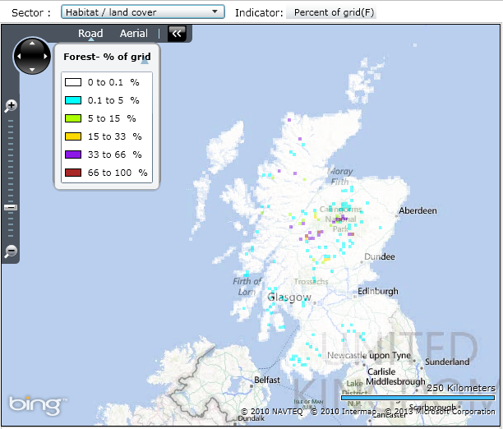
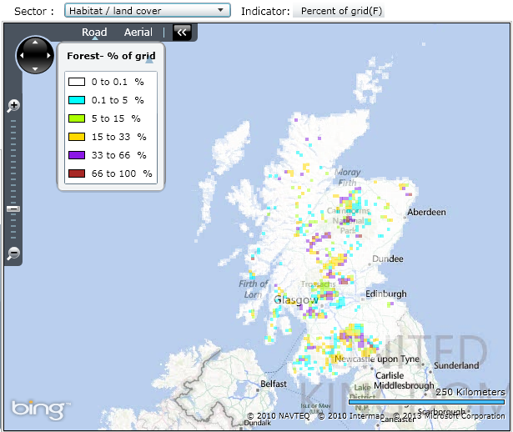
What are the local vs global trade-offs in food and timber production?
Forest area (% of 5km grid) based on the UK National Ecosystem Assessment (NEA) scenarios
World Markets
National Security
Nature@Work
Green & Pleasant Land
Source: James Paterson, University of Edinburgh
Notes:
Intensive farming

Slide 10
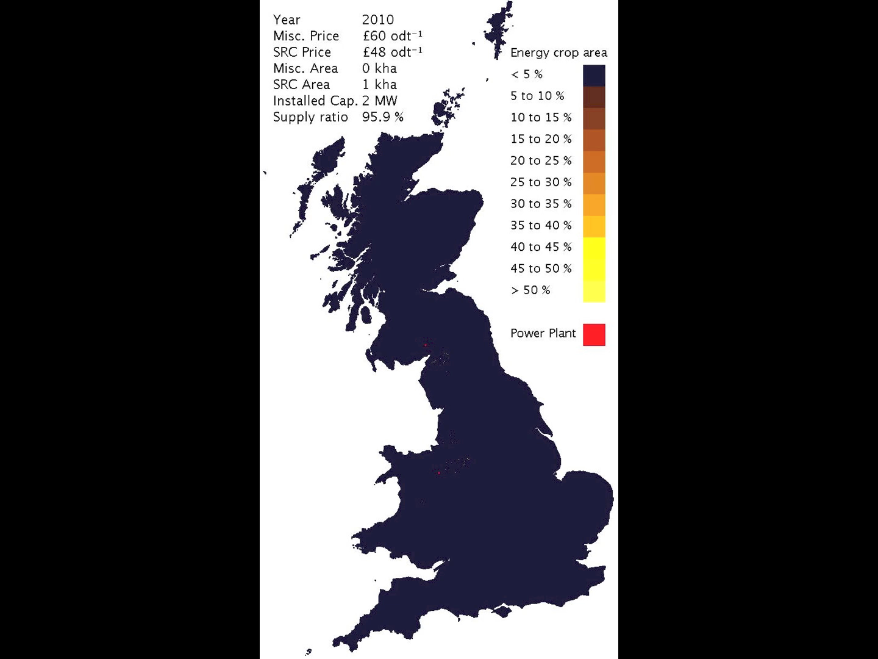
How quickly are climate mitigation policies adopted?
The uptake of energy crops (miscanthus and Short Rotation Coppicing)
Alexander, P., Moran, D., Rounsevell, M.D.A. & Smith, P. (2013). Modelling the perennial energy crop market: the role of spatial diffusion. Journal of the Royal Society Interface, 10, 20130656 doi: 10.1098/rsif.2013.0656

Slide 11
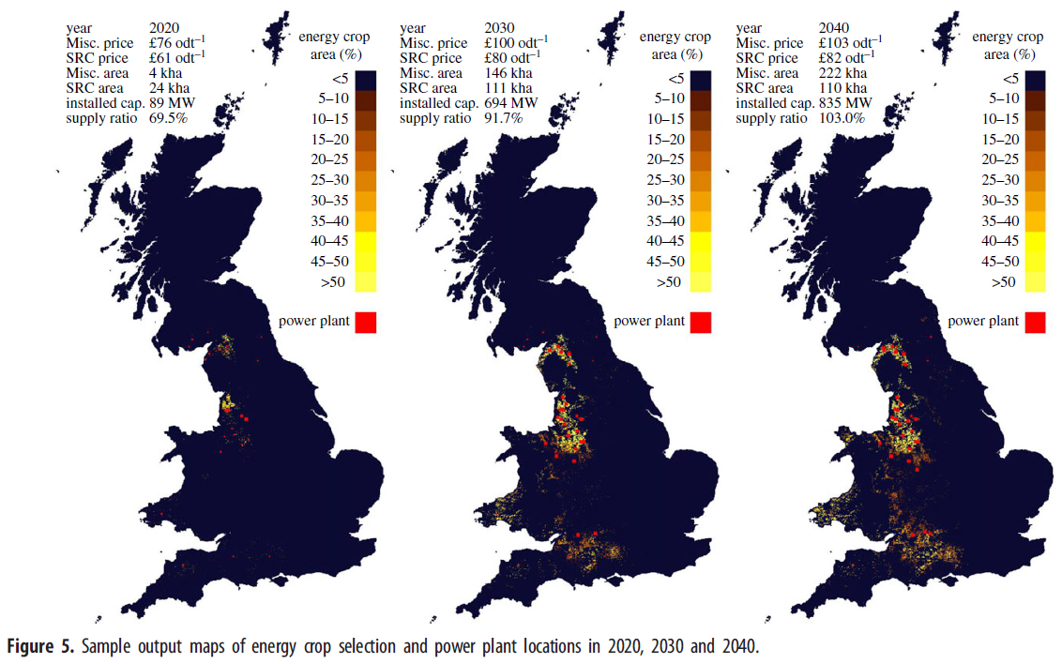
Simulation of the uptake of the bioenergy crops miscanthus and short rotation coppicing
Alexander et al. (2013). Journal of the Royal Society Interface, 10, 20130656

Slide 12
Time lags in adaptation - historic oilseed rape data for England and Wales, against a baseline year of 1966, and mean modelled perennial energy crop areas, using a baseline year of 2010
(Source: Peter Alexander, SRUC, Edinburgh)
Alexander, P., Moran, D., Rounsevell, M.D.A. & Smith, P. (2013). Modelling the perennial energy crop market: the role of spatial diffusion. Journal of the Royal Society Interface, 10, 20130656 doi: 10.1098/rsif.2013.0656

Slide 13
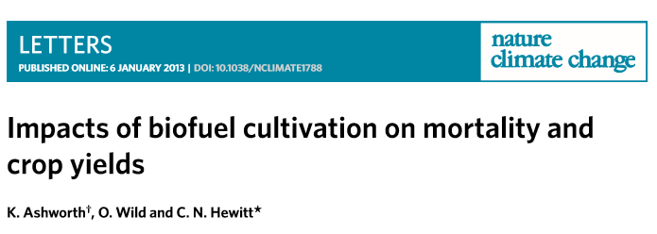
BVOC emissions from poplar and willow combine with NOx from combustion to produce ozone

Slide 14
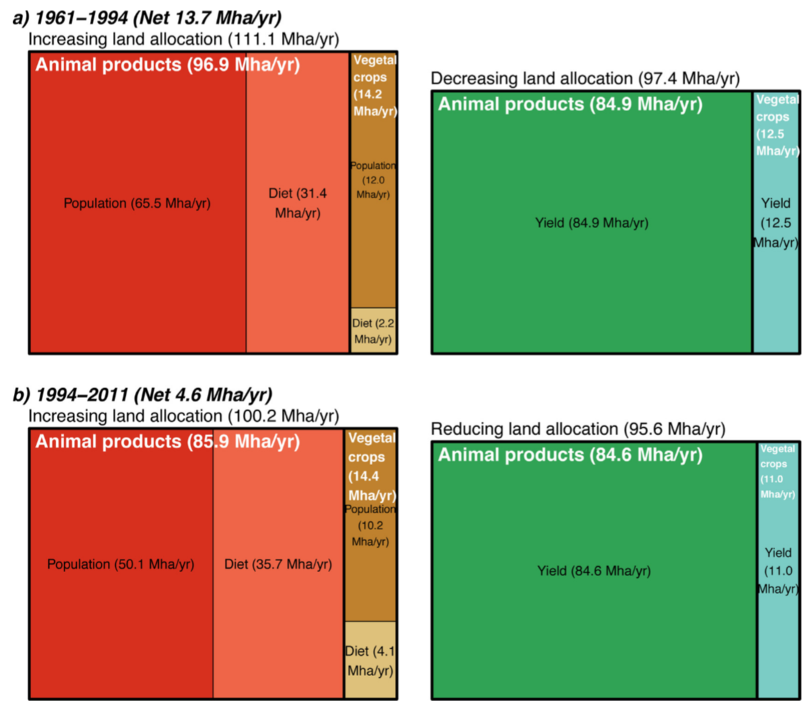
What are the changing drivers of food production?
Population
Diet
Yield change
Alexander, et al. (2015). Drivers for global agricultural land use change: the nexus of diet, population, yield and bioenergy. Global Environmental Change, 35, 138-147

Slide 15
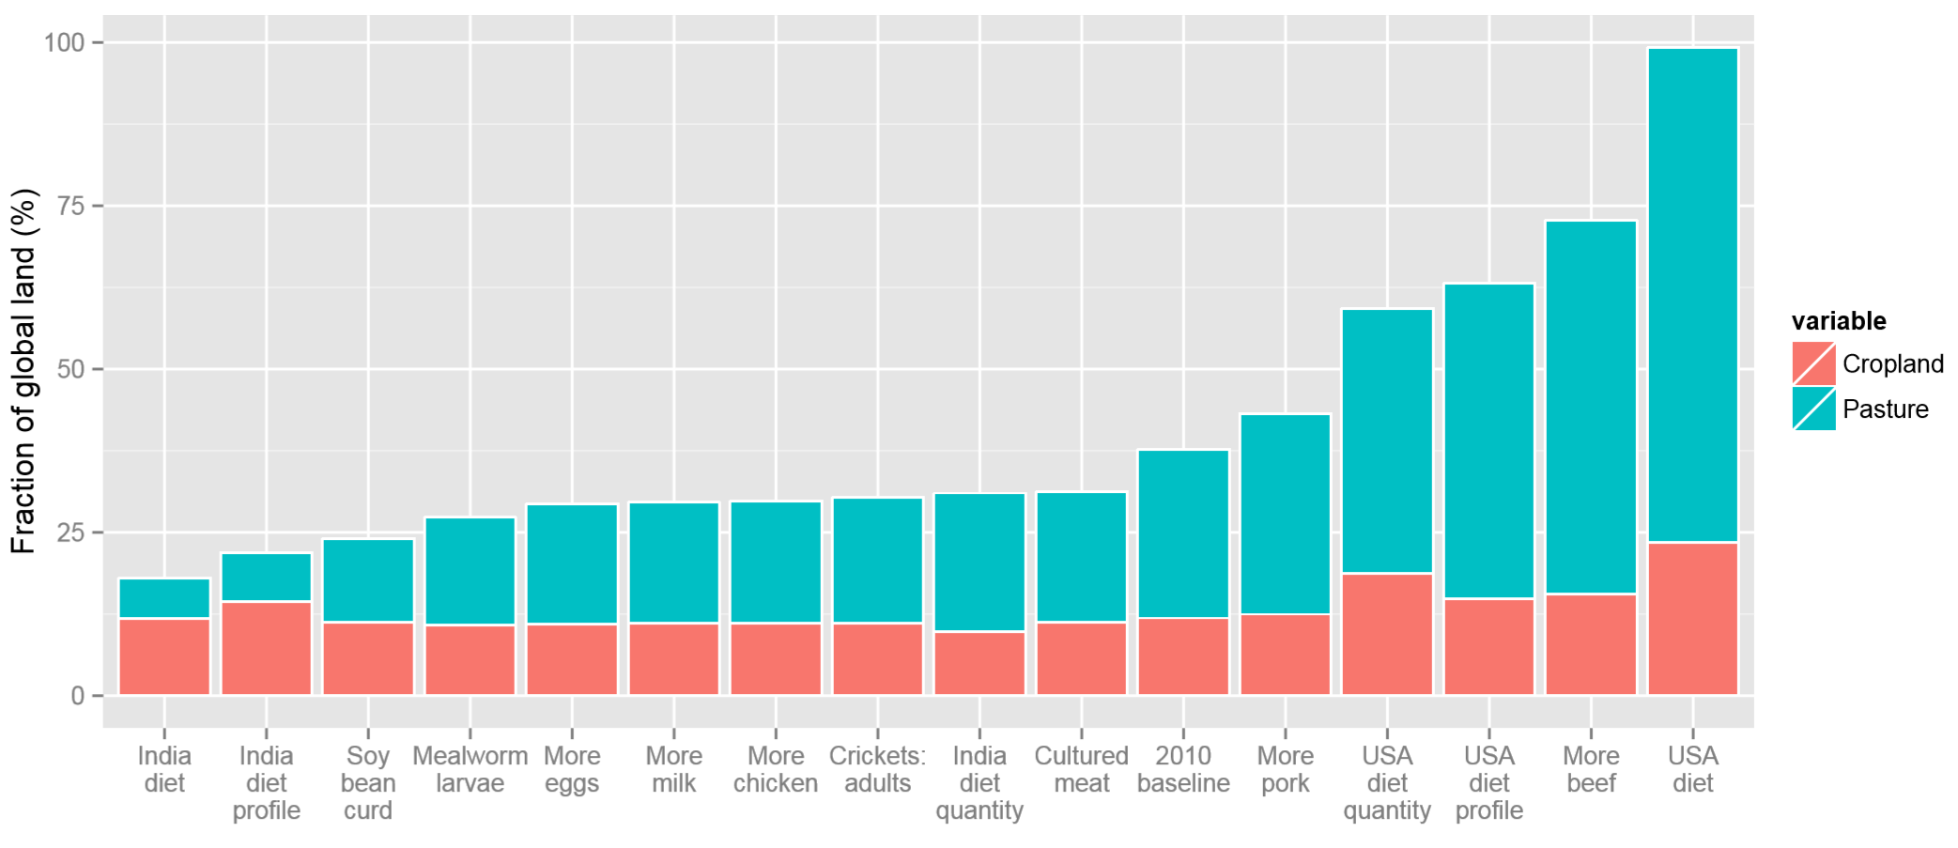
How much land could become available for climate mitigation & nature? The role of diet …
The insect and cultured meat scenarios assume the substitution of 50% of existing animal product consumption
The national diets scenarios assume the whole world adopts that diet
Caveats: a) land area expansion is associated with declining yields (so more area is needed!), and b) no consideration of future technologically-driven yield increases

Slide 16
Key messages
The environmental impact of land-based mitigation – biodiversity and air quality
Land use extensification vs intensification
Local vs global production and displacement effects
The role of diet in land availability for climate mitigation and nature
Time-lags in the uptake of land-based mitigation

Slide 17
Any questions?

Slide 18
Questions
How can the negative effects of BECCS on biodiversity be avoided?
What alternative land use futures can support land-based mitigation?
  Can consumer patterns (i.e. dietary change) provide more land for land-based mitigation as well as conservation?
  Can we create scenarios of future land-use that go beyond the climate change debate?
How can we overcome lags in the uptake of land based mitigation policies (actions on the ground)?

Slide 19
Questions
Do we have the data to identify the consequences and monitor land-use change from a natural as well as socio-economic systems perspective?
How can we embed climate mitigation actions into other sectoral policies (agricultural policy, conservation) – integrated policies for multiple benefits?
  Since it is implausible to have UNFCCC and e.g. CBD to negotiate at the same time in the same place (global policy), how can we ensure that when implementing policies locally/regionally, co-benefits are thought through?
How can we consider the biophysical climate effects of land based mitigation?
How should we address the deterioration in air quality arising from woody bioenergy?

