Slide 1
^{The Forest and Landscape}
^{Restoration Mechanism}
Key messages of the World Forestry Congress and the Forest and Landscape Restoration Mechanism
David Cooper on behalf of FAO
CBD representative in the FLR Mechanism Advisory Group
Biodiversity and ecosystem restoration: meeting the climate challenge – Paris – France

Slide 2
Key messages of the series of side events on Forest and Landscape Restoration organized at the World Forestry Congress in Durban

Slide 3
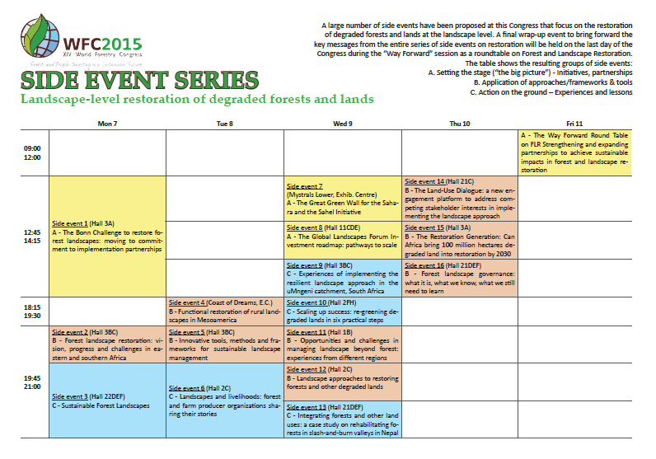
Eighteen side events held at the World Forestry Congress
Final round table held on September 11, 2015 at the World Forestry Congress

Slide 4
Final round table held at the World Forestry Congress
Some key messages of the final round table of Forest and Landscape Restoration organized on September 11, 2015
Forest and Landscape Restoration (FLR) can be the solution to achieve multiple land use objectives. Landscape approach is recognized as the solution to integrate different land uses and minimize conflicts.
There is a clear understanding that FLR can be an effective package to generate and share different benefits such as biodiversity, food security, climate mitigation and adaptation, improve livelihoods, etc.
FLR approaches can help to articulate government agendas and can contribute to improve governance. The political support needs to be capitalized but inter sectoral coordination still need to be improved ...
The governance at the landscape level is also key and require to engage local stakeholders (land tenure has to be clear and secured for all local communities)

Slide 5
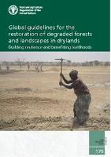
Final round table held at the World Forestry Congress
Some key messages of the final round table of Forest and Landscape Restoration organized on September 11, 2015
The multiple benefits are essential to attracting and scale up Forest and Landscape Restoration but not always have to be monetized. Need for a package of incentives including economic and non-economic benefits from Forest and Landscape Restoration
The regional initiatives (Such as Initiative 20 * 20 in Latin America or the GGWSSI and the African Restoration Initiative) can help countries to learn from each others and accelerate Forest and Landscape Restoration
The natural regeneration and assisted natural regeneration has proven, in several areas, to be the cheapest restoration options. FLR has been focused a lot of plantations which is sometimes too expensive.

Slide 6
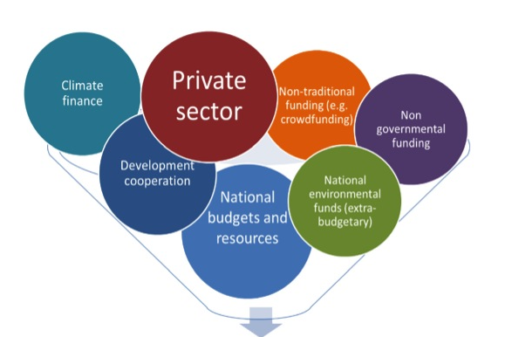
Final round table held at the World Forestry Congress
Some key messages of the final round table of Forest and Landscape Restoration organized on September 11, 2015
Increase engagement with the private sector, especially with private impact funds and other innovative initiatives such as layered funds that can benefit from the support of governments and public institutions
Establish risk mitigation mechanisms to engage Forest and Landscape Restoration investors at scale (Guarantee mechanisms, Sustainable Investment Criteria (PRI) and consistent MRV tools)
Adapt the legal framework to attract investors on FLR:
Land tenure rights ;
Benefit sharing mechanisms ;
Fair investment regulations.
Improve Costs-Benefits Analysis of FLR
Compile existing data and design a CBA data base ?
Improving data quality for indirect costs and benefits ?
Propose a ex-ante CBA tool ?

Slide 7
Forest and Landscape
Restoration Mechanism (FLRM)

Slide 8
The Forest and Landscape Restoration Mechanism (FLRM)
Launch of the Forest and Landscape Restoration Mechanism
FAO, as a GPFLR member, had a reflection on its best possible role within this global partnership in order to achieve common goals and objectives
GPFLR has already lots of success in raising awareness at global level with the Bonn Challenge (pledges), Aichi Targets, etc.
FAO support should be focused on progress on the ground and on need to scale-up FLR efforts
Official launch of the Forest and Landscape Restoration Mechanism in June 2014 (COFO) in order to increase its support to field programs (with key support of the KFS)

Slide 9
The Forest and Landscape Restoration Mechanism (FLRM)
Main goal of the Forest and Landscape Restoration Mechanism
Goal
To support the planning, funding and implementation of Forest and Landscape Restoration efforts mainly at country level
Key considerations
We know the “what” but we need to better focus on the “how”
mainly at country level to maximize impact on the ground
in a consistent way with other key partners to avoid duplication
with an initial phase of seven year from 2014 to 2020

Slide 10
The Forest and Landscape Restoration Mechanism (FLRM)
Facilitation process at country level on the following key issues:
Research needs
Private sector investment
Institutional setting
Assessment of Degradation and Restoration Opportunities
Achieving Aichi Target 15 or Bonn Challenge Pledge
Resource mobilization
Governance issues (tenure, local community involvement, etc.)
Enabling Environment (policies/laws)
Technologies and Approaches
Notes:
Idea is to ensure that different action areas are connected as process moves forward.

Slide 11
The Forest and Landscape Restoration Mechanism (FLRM)
Main actions of the FLRM at the global/regional levels
Financial resources mobilization function (projects proposals submitted to bilateral/multilateral donors, private sector mobilization, preparation of a Discussion Paper on Sustainable Financing for FLR with Global Mechanism, etc...)
Development of guidelines & standards for baselines and verification of successful Forest and Landscape Restoration efforts (in collaboration with other GPFLR members)
Dissemination of existing knowledge on Forest and Landscape Restoration at regional/country levels through existing regional networks/initiatives (Silva Mediterranea, Initiative 20*20 etc…)
Contribution to more effective reporting to RIO Conventions and any other relevant international organizations, processes or initiatives (e.g. UNCCD, CBD, UNFCCC, Bonn Challenge)

Slide 12
The Forest and Landscape Restoration Mechanism (FLRM)
The way forward after the first Advisory Group in Rome (July 2015)
Work Plans currently implemented in seven selected countries with available financial resources (FAO-TCP projects and FLRM funds from Sida and Korea Forest Service) : Guatemala, Peru, Cambodia, Philippines, Lebanon, Uganda and Rwanda and support to DPRK ;
Preparation of new project proposals with a group of ‘’candidates’’ considered as eligible for a FLRM future support (depending on additional resource mobilization) based on requests received in June 2015 : Burkina Faso and Niger (Project proposal in preparation with France), Jordan, Ecuador, Ethiopia, Vietnam and Sudan
Development of a Programmatic Approach on FLR (TRI Program) with several partners (IUCN and UNEP) for funding under GEF6 with several ‘’child projects’’ with FAO as executive agency (confirmed Letter of Endorsement of National GEF focal points for Central African Republic, Democratic Republic of Congo, Kenya, Pakistan and Sao Tome and Principe)
Notes:
Idea is to ensure that different action areas are connected as process moves forward.

Slide 13
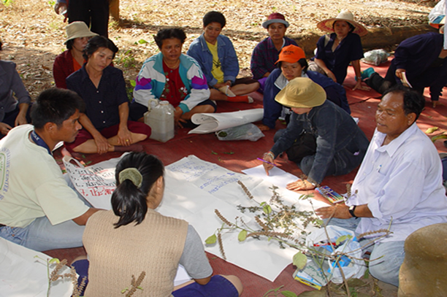
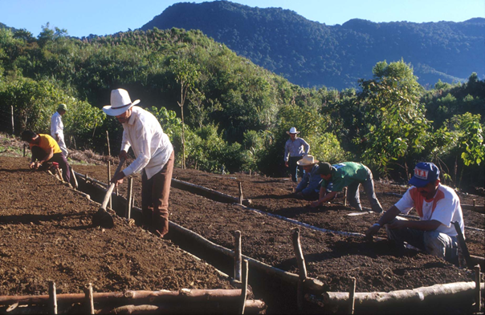
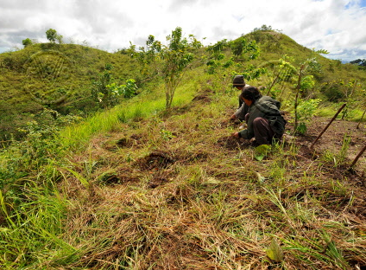
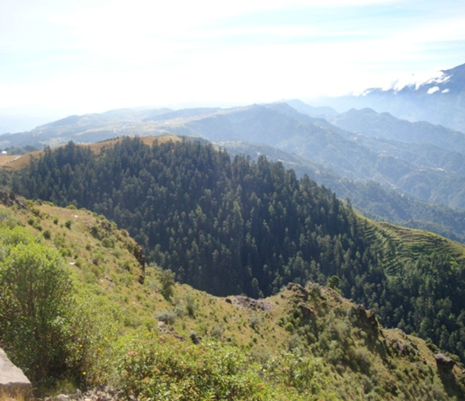
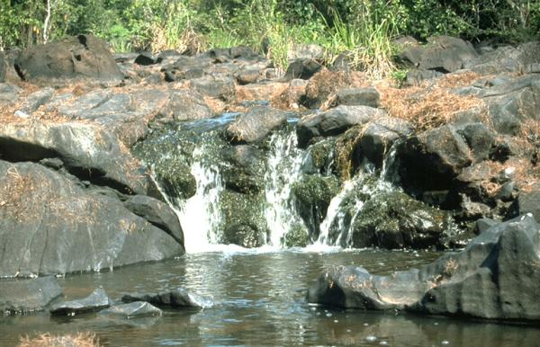
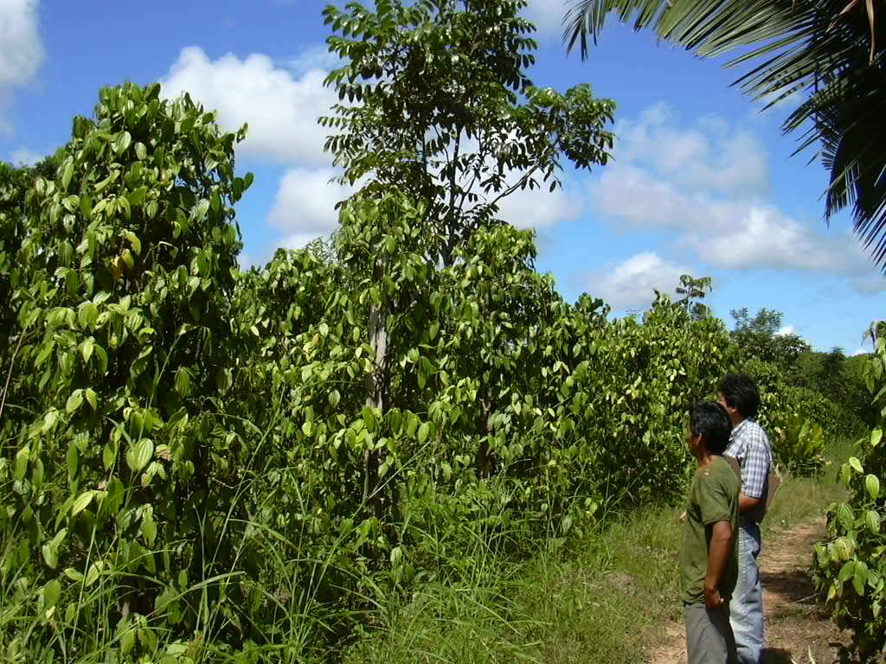
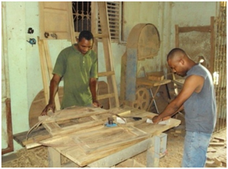
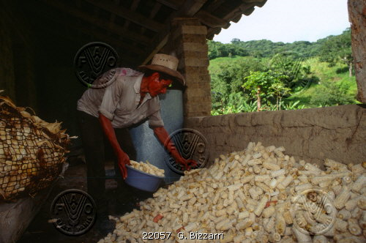
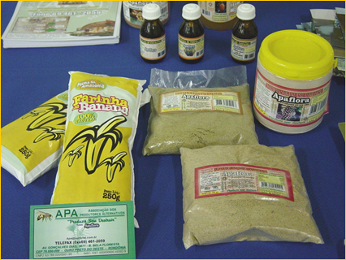
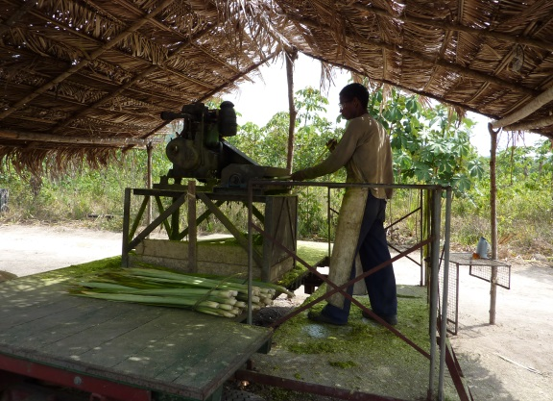
Thank you

